Slide 1
A2 - Needfinding
Team 2: JAI DED
Ecem “AJ” Yilmazhaliloglu
Alexander Yue
Diego Valdez Duran
Evan Hsu

Slide 2
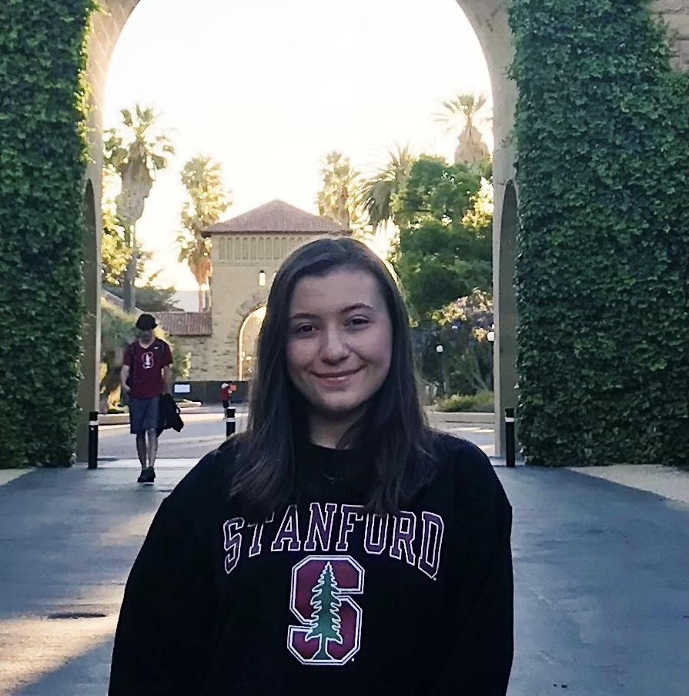
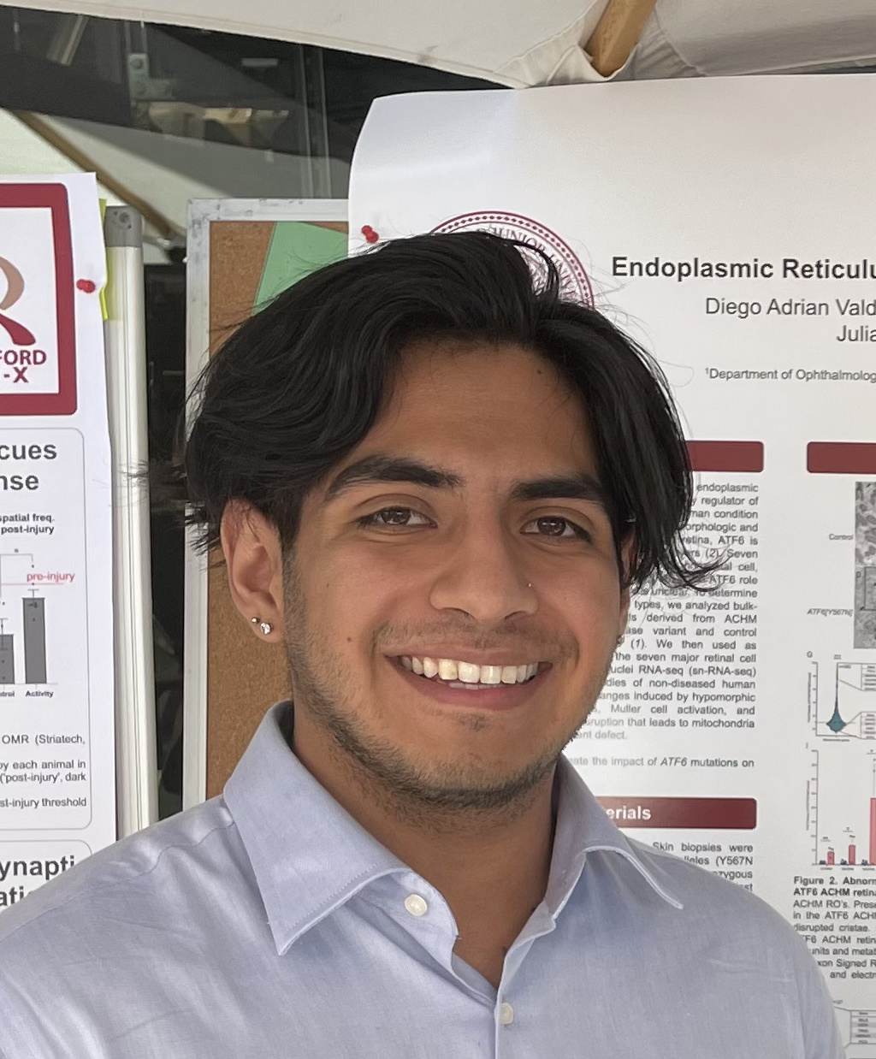
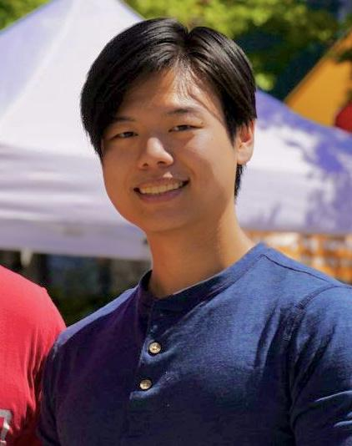

Our Study Group
Evan Hsu
’25
Alexander Yue
Coterm
Rancho Cucamonga, CA
BS Physics
Sacramento, CA
’25
Ecem Yilmazhaliloglu
Diego Valdez Duran
BS CS
Istanbul, Turkey
Coterm CS
Aspen, CO
’27
’25

Slide 3
Refined Problem Domain
People who use the US undergraduate education system
Group collaboration among US undergraduate students

Slide 4
01
Additional Needfinding

Slide 5

Participants
N E W !
Interviewee 5
Interviewee 1
Masters student at UC San Diego
Person taking a gap year after high school
Interviewee 6
Interviewee 2
Current student at Stanford
Interviewee 4
Current student at UC Berkeley
A recent graduate from UC Davis
Interviewee 3
Current student at UC Berkeley
Usage of college education
Less extreme
More extreme

Slide 6

Interviewee 5 - Masters Student @ UCSD
Context
Key Quotes
Hometown is Sunnyvale
Electrical Engineering Major
Lives-off campus
“One of my motivations was this legend on Reddit, like, was his name is Shivam. He did three majors in three years, and he did pure math, pure physics, and CS”
“Fun class, though, even though I got like a b minus in that class, I looked back and that was probably the class I learned the most, not just about content wise, but more about how flawed some of my study philosophies are. But I like that.”
“So I basically joined his friend group, and … I became 10 times more social my second year than my first year. Because of that, I'm very thankful that I went off campus, because being off campus really forces you to stay at school.”
Stock Image by Freepik

Slide 7
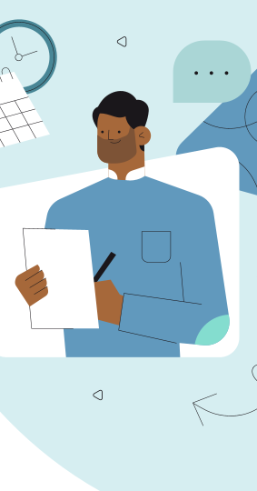
Key learnings
Taking on difficult challenges is highly motivating to some students
Students are brought together most under hard circumstances

Slide 8
POV #5
WE MET…
WE WERE SURPRISED TO NOTICE…
“Mike,” a Master's student at UCSC who achieved extreme academic success through advanced classwork and skipping prerequisites
Although he attributes great value to GPA, his favorite class was one where he received a low grade in, but made friends through the shared challenge.
WE WONDER IF THIS MEANS
IT WOULD BE GAME CHANGING IF…
The growth from challenging classes outweighs the difficulty of taking them and loss of GPA.
Students could find engaging challenge in their classes in a way that does not hurt their GPA.

Slide 9

Interviewee 6 - Coterm Student @ Stanford
Context
Key Quotes
Hometown is San Francisco
Master’s candidate in Community Health and Prevention Research (CHPR)
Pre-med
“[for my healthcare leadership class] … I really liked the diverse set of guest speakers. It showed a humanistic side of medicine”
“Without smaller groups in some of my classes, it’s harder to stay motivated. It feels like more of a drag when you can’t engage with the material on a deeper level”
“I prefer working alone when studying for tests, but I really enjoy collaboration in my project-based classes”
“Sometimes I struggle to reach out to other students because of imposter syndrome, or duck syndrome. I feel like ‘I should be able to figure this out on my own’.”
Stock Image by Freepik

Slide 10
Key learnings
Engagement is key to learning
There are personal barriers to peer collaboration
Notes:
Engagement- working in smaller groups and interesting guest speakers
Personal barriers: ‘imposter syndrome’, social anxiety

Slide 11
POV #6
WE MET…
WE WERE SURPRISED TO NOTICE…
“Tim,” a pre-med coterm student at Stanford who is working very hard to finish a 4-quarter long masters program in 3.
Although he prefers to work with peers on problem sets and group projects, he is sometimes afraid to reach out due to the feelings of “imposter syndrome”.
WE WONDER IF THIS MEANS
IT WOULD BE GAME CHANGING IF…
Students could find study partners in their classes without the burden of impostor syndrome or social anxiety.
Since he thinks, “I should be able to figure this out on my own”, he will refrain from reaching out to peers even if it benefits him and increases his motivation

Slide 12
02 & 03
POV & HMW’S

Slide 13
Refined POV: Interviewee #1
WE MET…
WE WERE SURPRISED TO NOTICE…
“Jane,” a highschool graduate taking a gap year to reapply to college, who feels she hasn’t been supported enough during the college applications process.
She believes guidance from others would have helped her with college applications, but doesn’t know how to reach out to others for feedback.
WE WONDER IF THIS MEANS
IT WOULD BE GAME CHANGING IF…
The anxiety of opening up to other students about her application is causing her to fall behind
Students had assistance in sharing their application experiences and tips.

Slide 14
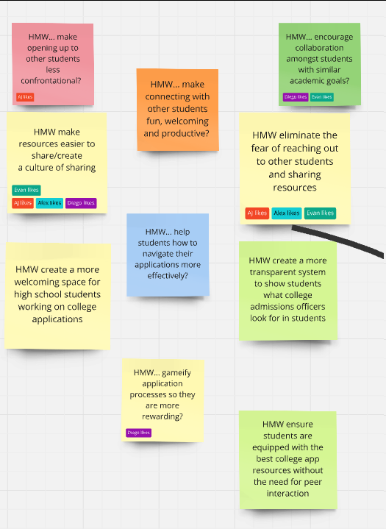
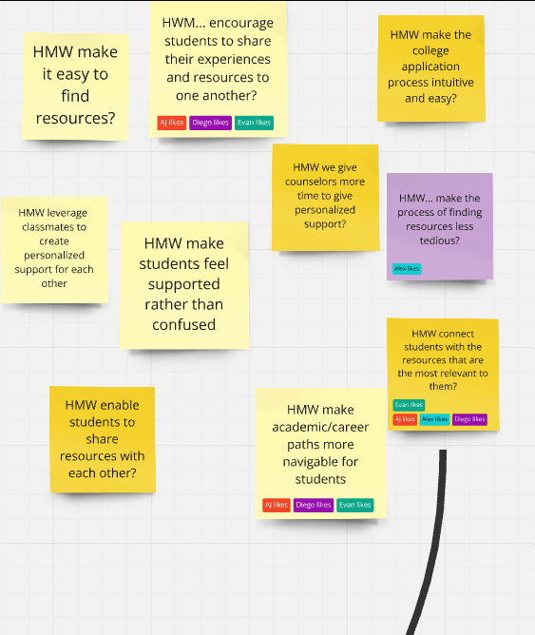
HOW MIGHT WE…
HOW MIGHT WE…
HOW MIGHT WE…
HOW MIGHT WE…
HOW MIGHT WE…
HOW MIGHT WE…
Interviewee 4
Interviewee 3
Interviewee 1
Interviewee 1
A recent graduate from UC Davis
Interviewee 1
Interviewee 1
Current student at UC Berkeley
Student taking a gap year after high school
Student taking a gap year after high school
Student taking a gap year after high school
Student taking a gap year after high school
connect students with the resources that are the most relevant to them?
group students with similar study schedules to optimize collaboration time?
eliminate the fear of reaching out to other students and sharing resources?
Notes:
HMW’s Generated: 1. HMW... make opening up to other students less confrontational?
2. HMW... encourage collaboration amongst students with similar academic goals?
3. HMW... make connecting with other students fun, welcoming and productive?
4. HMW make resources easier to share/create a culture of sharing?
5. HMW eliminate the fear of reaching out to other students and sharing resources?
6. HMW... help students how to navigate their applications more effectively?
7. HMW create a more welcoming space for high school students working on college applications?
8. HMW create a more transparent system to show students what college admissions officers look for in students?
9. HMW... gameify application processes so they are more rewarding?
10. HMW ensure students are equipped with the best college app resources without the need for peer interaction?

Slide 15
Refined POV: Interviewee #3
WE MET…
WE WERE SURPRISED TO NOTICE…
“Gavin,” a hardworking pre-med student at UC Berkeley who feels he has less prior academic experience than many others.
He believes collaboration is key to good grades, but works alone in classes where he does not know anyone.
WE WONDER IF THIS MEANS
IT WOULD BE GAME CHANGING IF…
The awkwardness of meeting new people is preventing him from reaching his academic goals.
Students felt comfortable working with each other in every class.

Slide 16
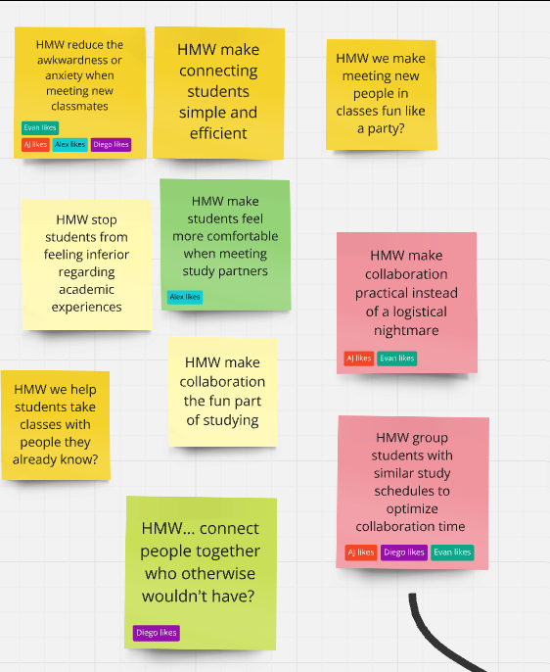
HOW MIGHT WE…
HOW MIGHT WE…
HOW MIGHT WE…
HOW MIGHT WE…
Interviewee 4
Interviewee 3
Interviewee 1
A recent graduate from UC Davis
Interviewee 1
Current student at UC Berkeley
Student taking a gap year after high school
Student taking a gap year after high school
connect students with the resources that are the most relevant to them?
group students with similar study schedules to optimize collaboration time?
Notes:
HMW’s Generated:
HMW reduce the awkwardness or anxiety when meeting new classmates?
HMW make connecting students simple and efficient?
HMW we make meeting new people in classes fun like a party?
HMW stop students from feeling inferior regarding academic experiences?
HMW make students feel more comfortable when meeting study partners?
HMW make collaboration practical instead of a logistical nightmare?
HMW make collaboration the fun part of studying?
HMW we help students take classes with people they already know?
HMW group students with similar study schedules to optimize collaboration time?
HMW... connect people together who otherwise wouldn't have?

Slide 17
Refined POV: Interviewee #4
WE MET…
WE WERE SURPRISED TO NOTICE…
Despite expressing difficulty in finding resources for classes and internships, Sofia was able to name a few that she successfully utilized.
"Sofia," a recent Environmental Science graduate from UC Davis, who often felt overwhelmed by the pressures of navigating both her academic and career journey.
WE WONDER IF THIS MEANS
IT WOULD BE GAME CHANGING IF…
Students could confidently navigate their academic & career paths utilizing personalized available resources.
The issue may not be an overall lack of resources, but that the resources don’t translate into clear, personalized support for students.

Slide 18
HOW MIGHT WE…
HOW MIGHT WE…
Interviewee 4
Interviewee 1
A recent graduate from UC Davis
Student taking a gap year after high school
connect students with the resources that are the most relevant to them?
Notes:
HMW’s Generated:
HMW make it easy to find resources?
HWM... encourage students to share their experiences and resources to one another?
HMW make the college application process intuitive and easy?
HMW we give counselors more time to give personalized support?
HMW... make the process of finding resources less tedious?
HMW leverage classmates to create personalized support for each other?
HMW make students feel supported rather than confused?
HMW connect students with the resources that are the most relevant to them?
HMW enable students to share resources with each other?
HMW make academic/career paths more navigable for students?

Slide 19
04
Solutions

Slide 20
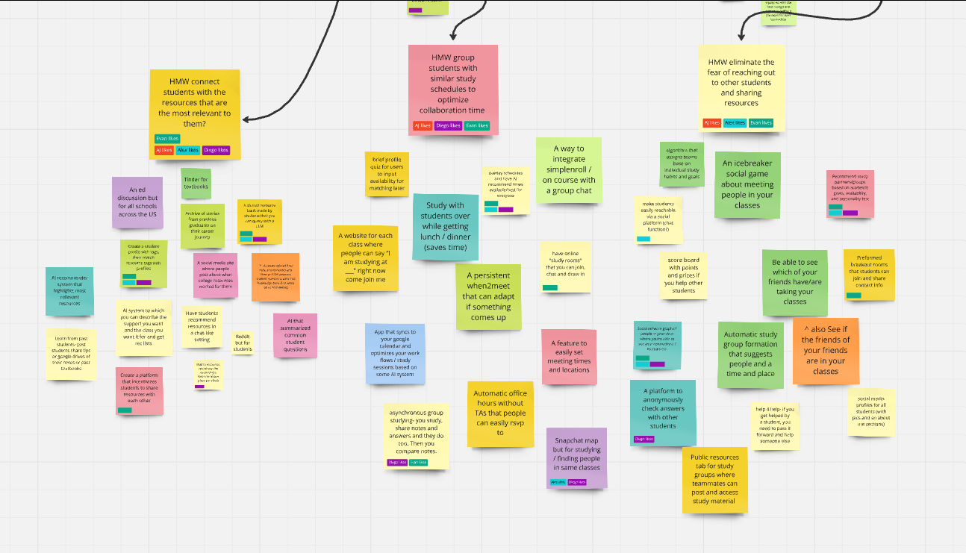
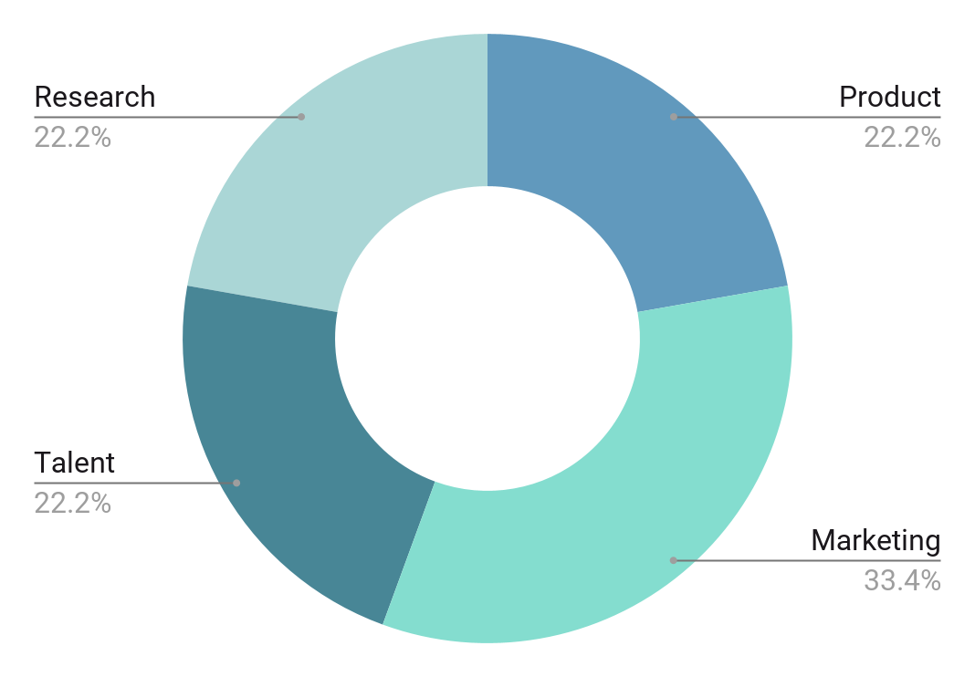
$1,000,000,000
$1,000,000,000
$1,501,000,000
$998,300,000
Research
Product development
Marketing
Talent acquisition
Follow the link in the graph to modify its data and then paste the new one here. For more info, click here

Slide 21
Solution Selection
HMW…?
Solution
1.
Eliminate the fear of reaching out to other students and sharing resources?
Recommend study partners/groups based on academic goals, availability, and personality test
2.
Group students with similar study schedules to optimize collaboration time?
Overlay schedules and have AI recommend times available/best for everyone
Connect students with the resources that are the most relevant to them?
3.
A shared resource bank made by students that you can query with a LLM

Slide 22
05
EXPERIENCE PROTOTYPES

Slide 23
Key Assumption #1
Solution
Assumption
People are open to making a school profile and be matched to other students
Recommend study partners/groups based on academic goals, availability, and personality test

Slide 24
Prototype Context #1
Assumption
People are open to making a school profile and be matched to other students
Experience Prototype
Props: Physical “profile worksheet” containing questions relevant to studying habits and characteristics. Discussions after completion.
Participants & Relevance: Participants were all Stanford students, mostly undergraduates under the engineering school. They were recruited through warm contacts.
Method: Person was asked to thoughtfully fill out the profile worksheet, and asked if they would be willing to form a study group with other participants, judging by their previously filled profiles.

Slide 25
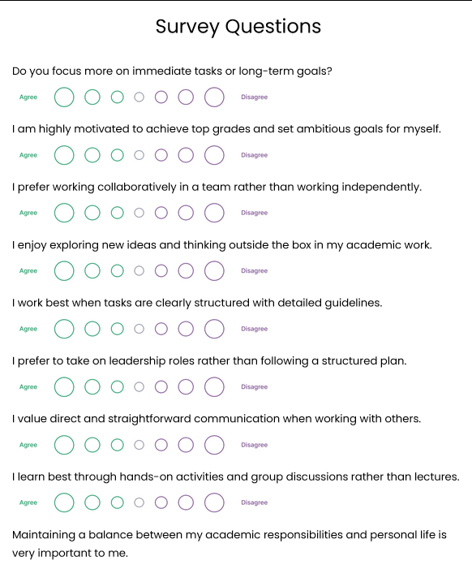
Description
We created a questionnaire that asks about study habits, personality and class expectations to determine the “fit” between potential study partners
Experience Prototype
What worked: Participants said it was both easy to use and informative on a personal level. Participants appeared to enjoy answering the survey questions and expressed interest in finding study partners in multiple classes.
What didn’t: Participants noted that the lack of definitive scheduling questions may lead to scheduling conflicts in the future
Assumption: Assumption validated. Students open to, and more than happy to, create profiles for themselves and match with those whose studying habits/personalities matched theirs

Slide 26
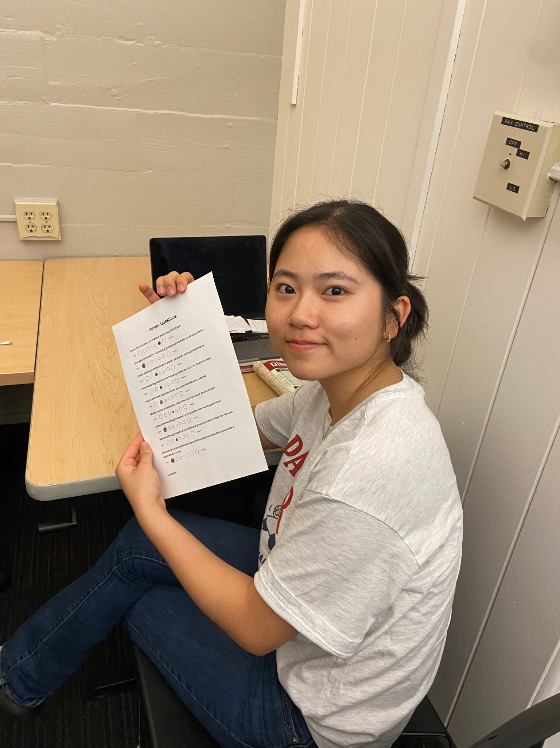
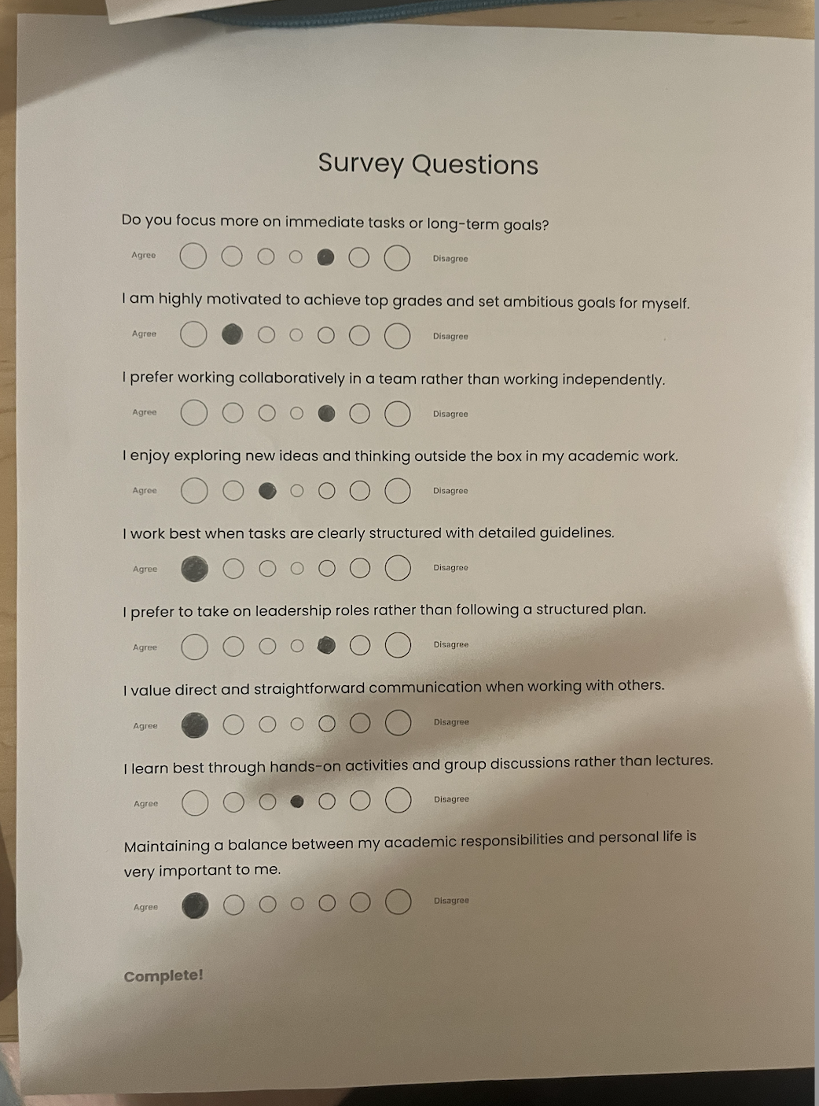
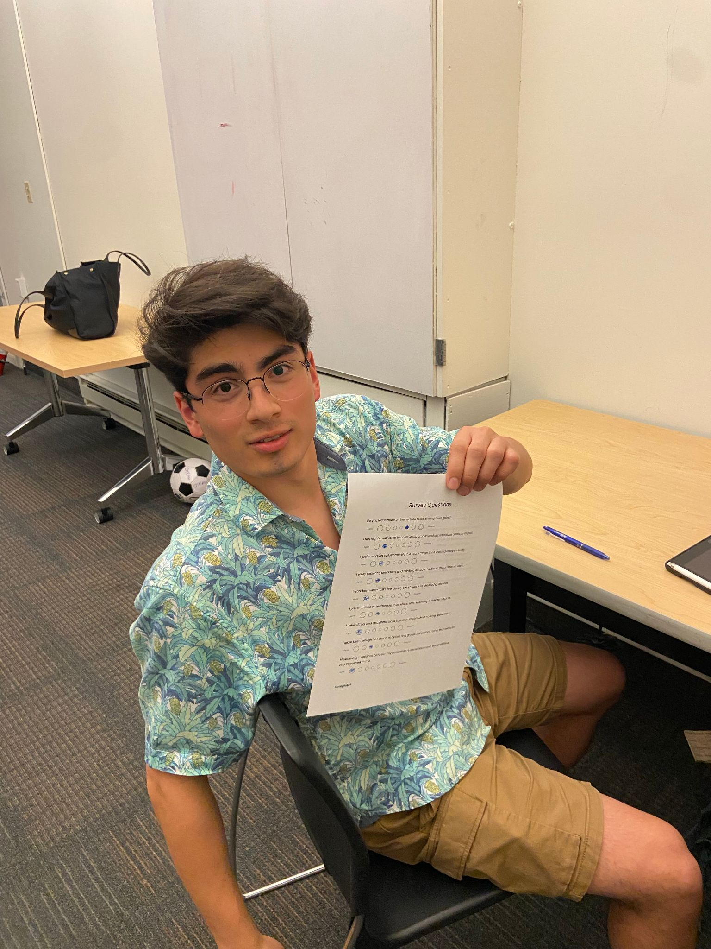
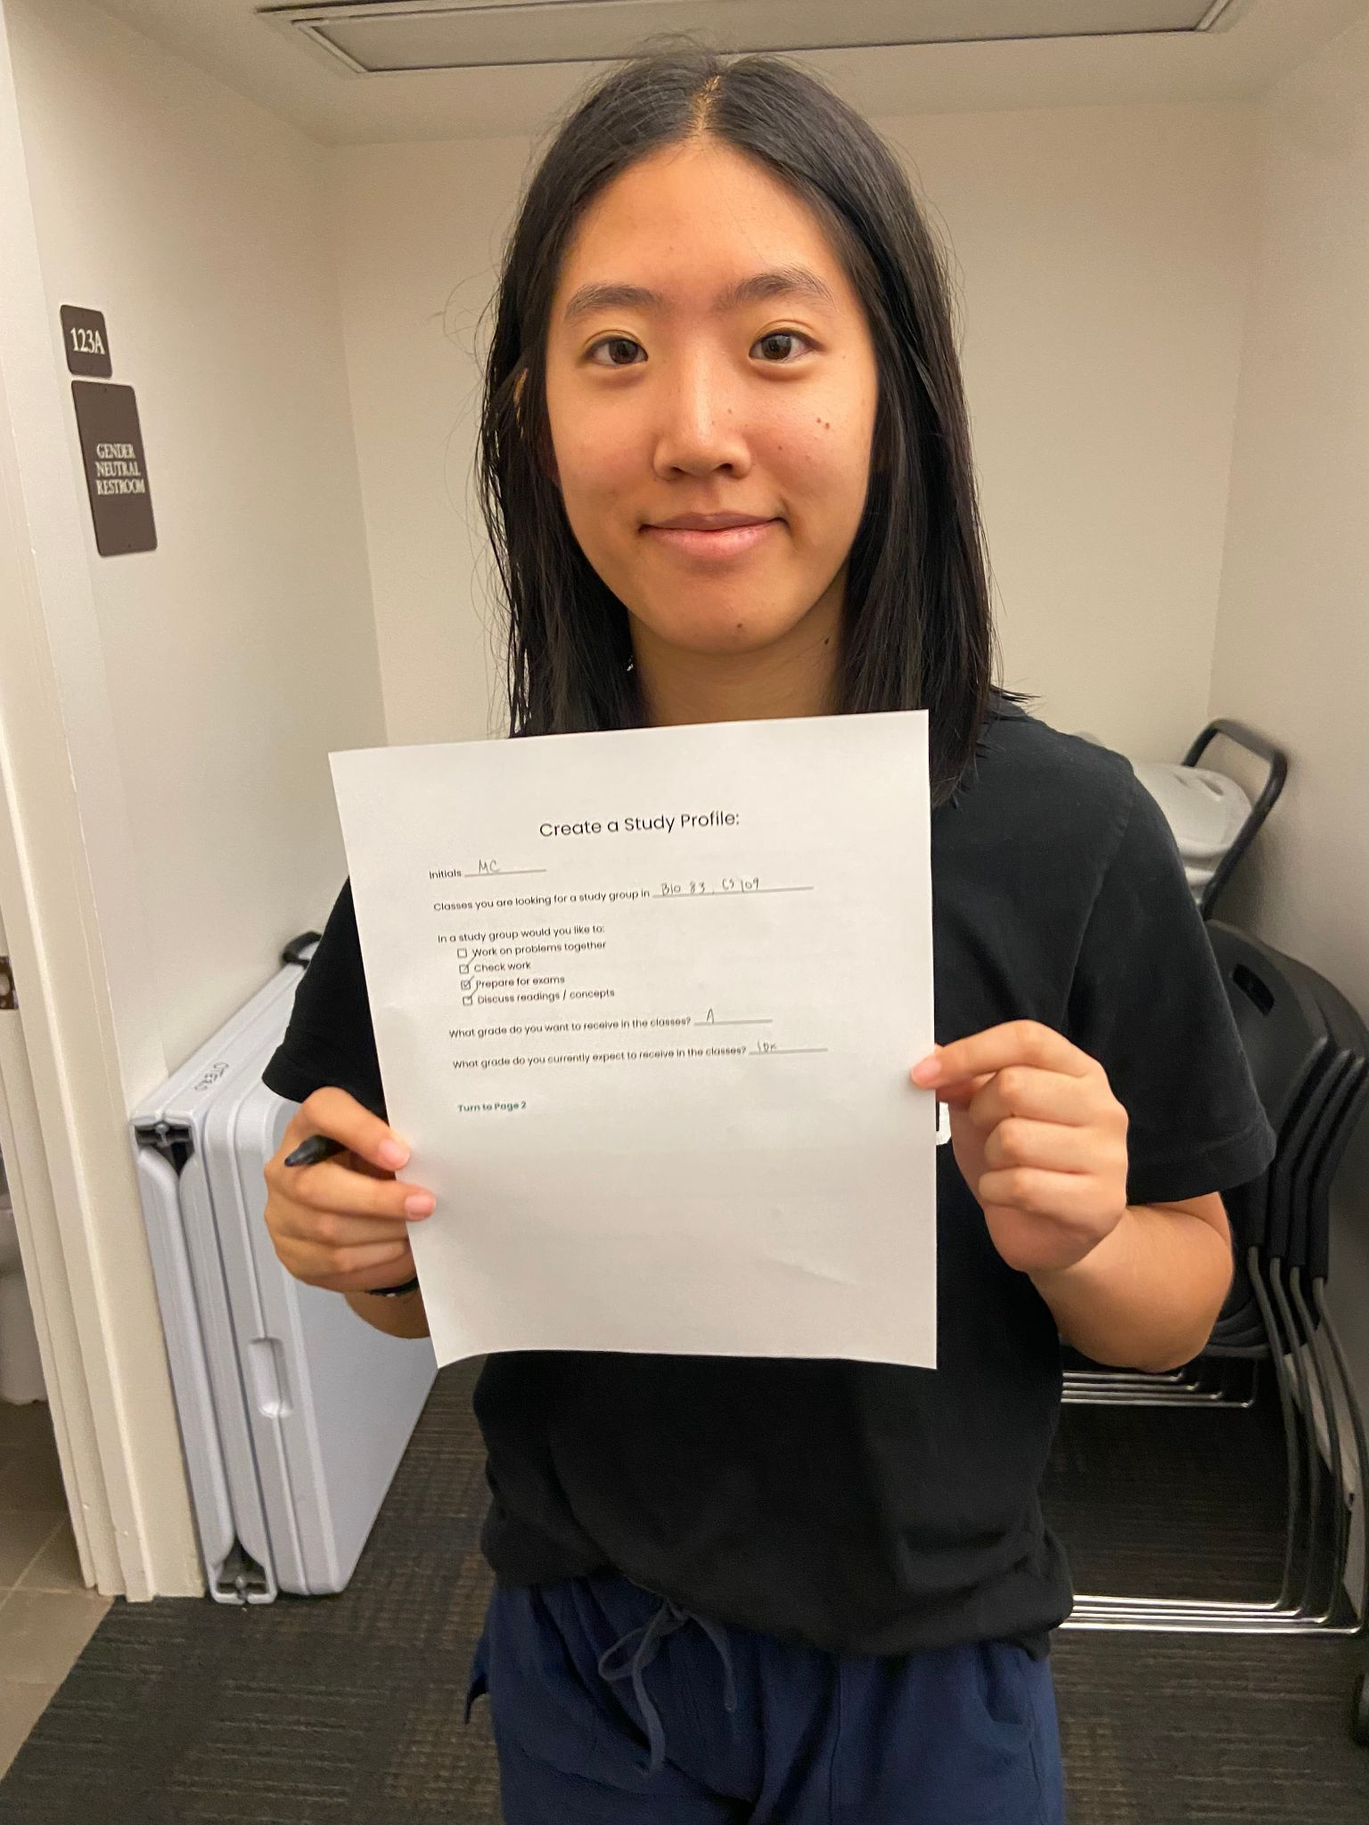
Photos!

Slide 27
Key Assumption #2
Solution
Assumption
People know and can share their study availability in advance
Overlay schedules and have AI recommend times available/best for everyone

Slide 28
Prototype Context #2
Assumption
People know and can share their study availability in advance
Experience Prototype
Props: Physical “schedule worksheet” containing questions relevant to scheduling availability. Discussions after completion
Participants & Relevance: Participants were all Stanford students, mostly undergraduates under the engineering school. They were recruited through warm contacts
Method: Person was asked to thoughtfully fill out the scheduling worksheet, and asked if they would be willing to form a study group with other participants, judging by their previously filled schedules

Slide 29
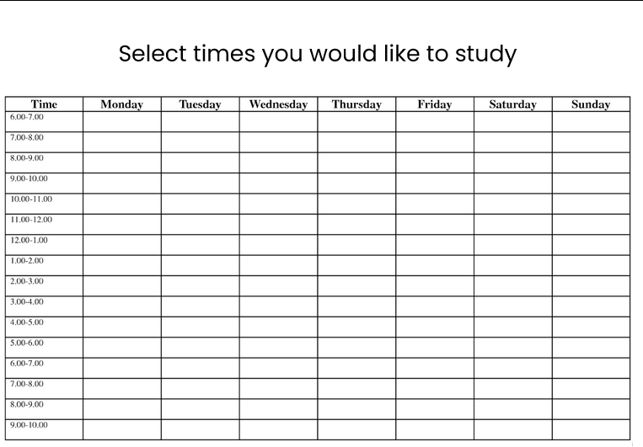
Description
We created a schedule where users can fill in the times that they would like to study
Experience Prototype
What worked: Participants said it was easy to fill and compare, yet insufficient in giving enough information about the potential study partner to be convincing
What didn’t: Participants noted that schedules vary a lot throughout the quarter and their availabilities could change unpredictably. In addition, participants expressed unpleasant feelings about planning logistics
Assumption: Assumption somewhat validated. Stanford students can plan their schedules beforehand, but are hesitant to make long-term commitments, and find the process unappealing.

Slide 30
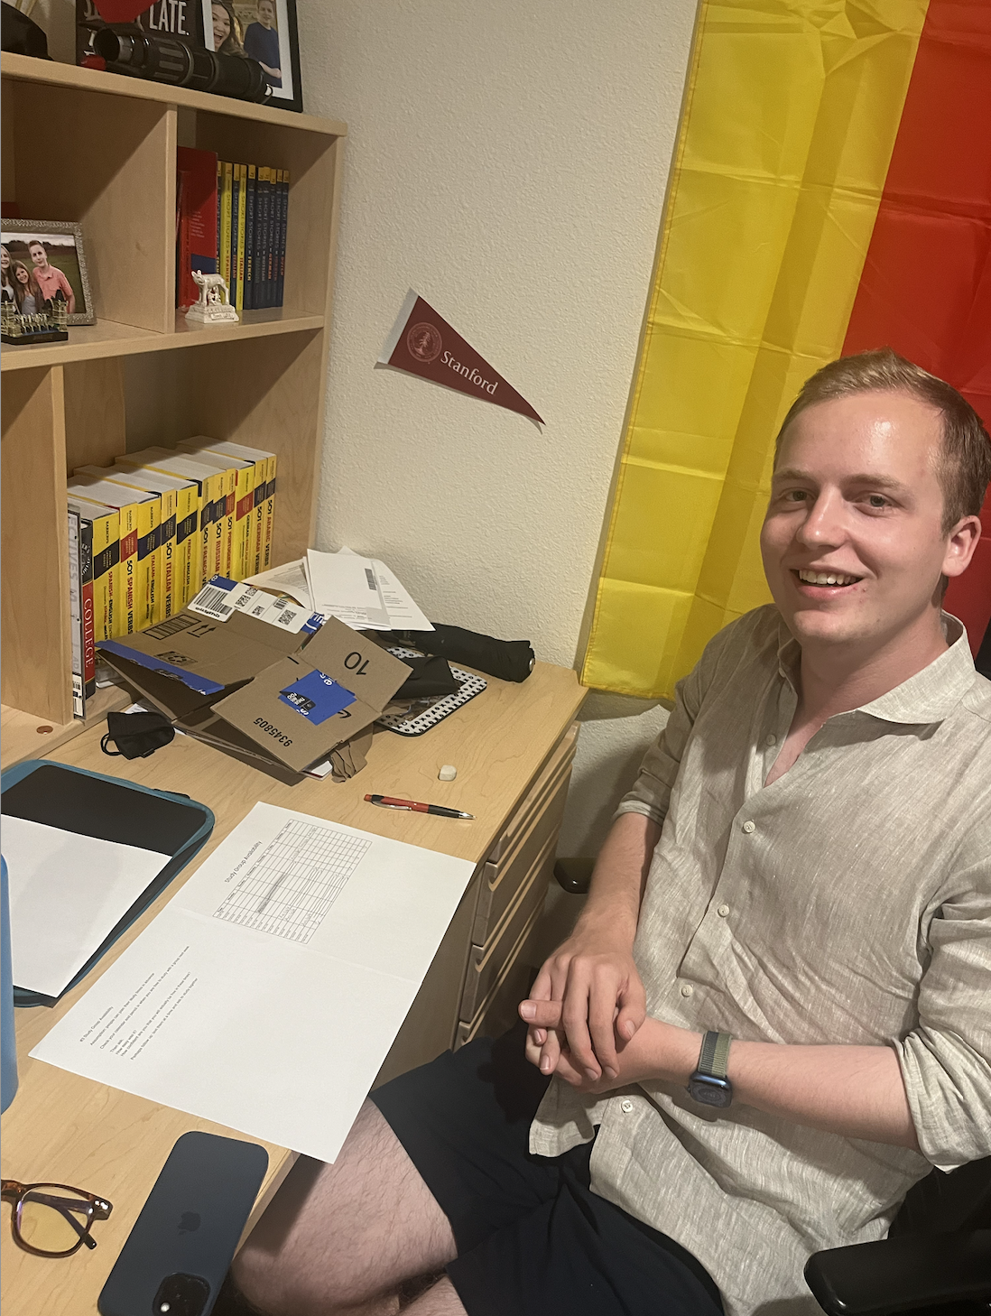
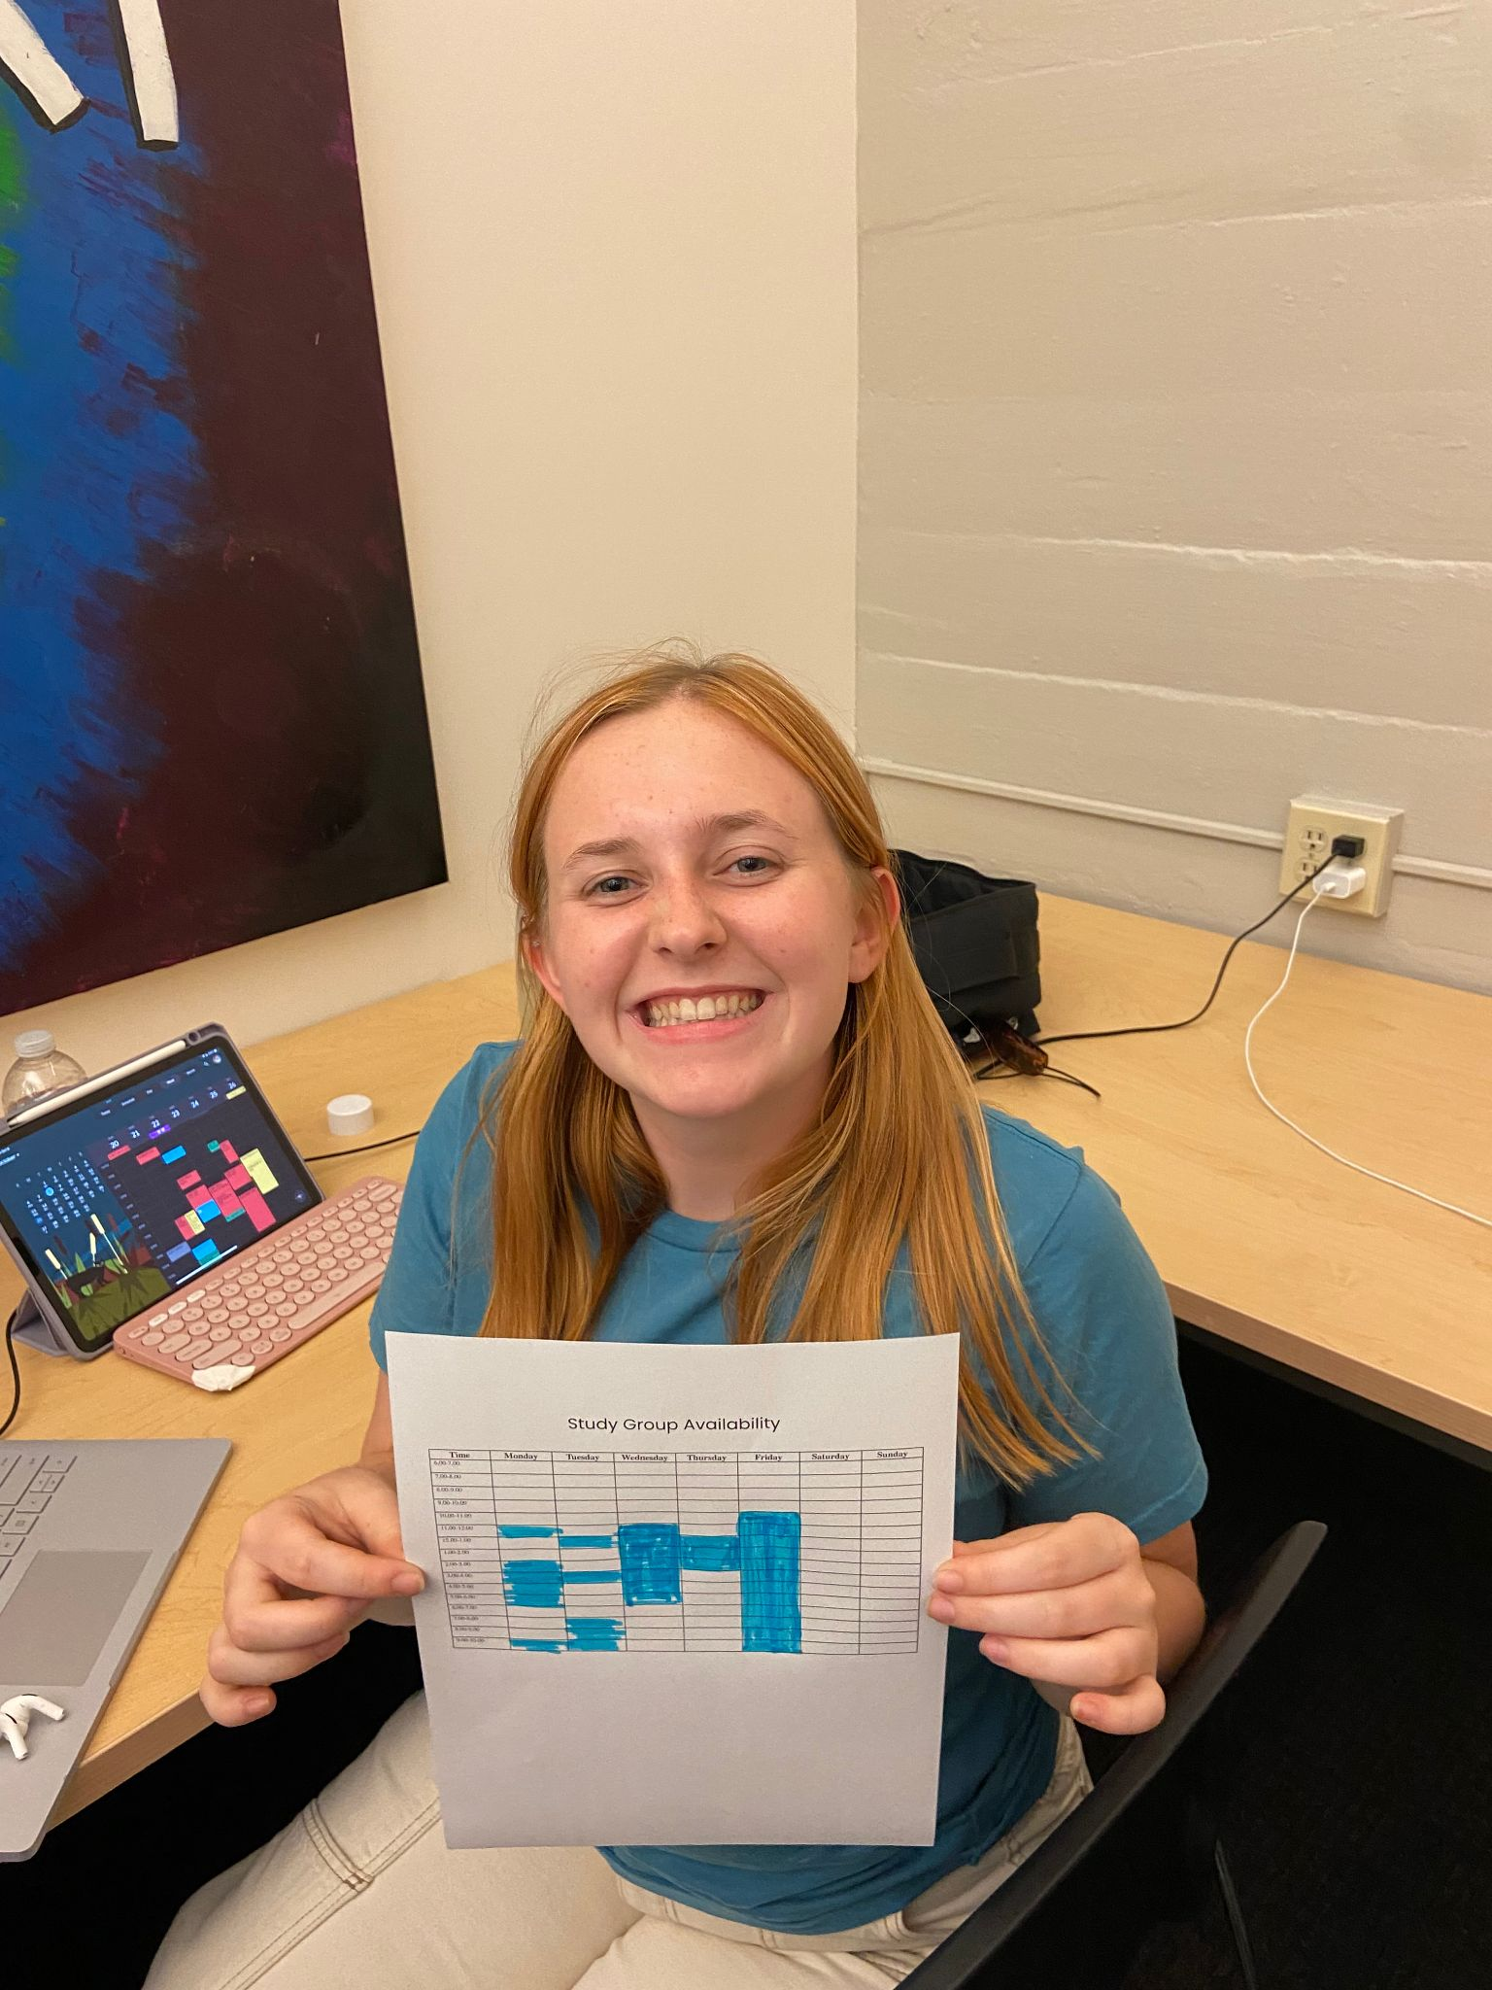
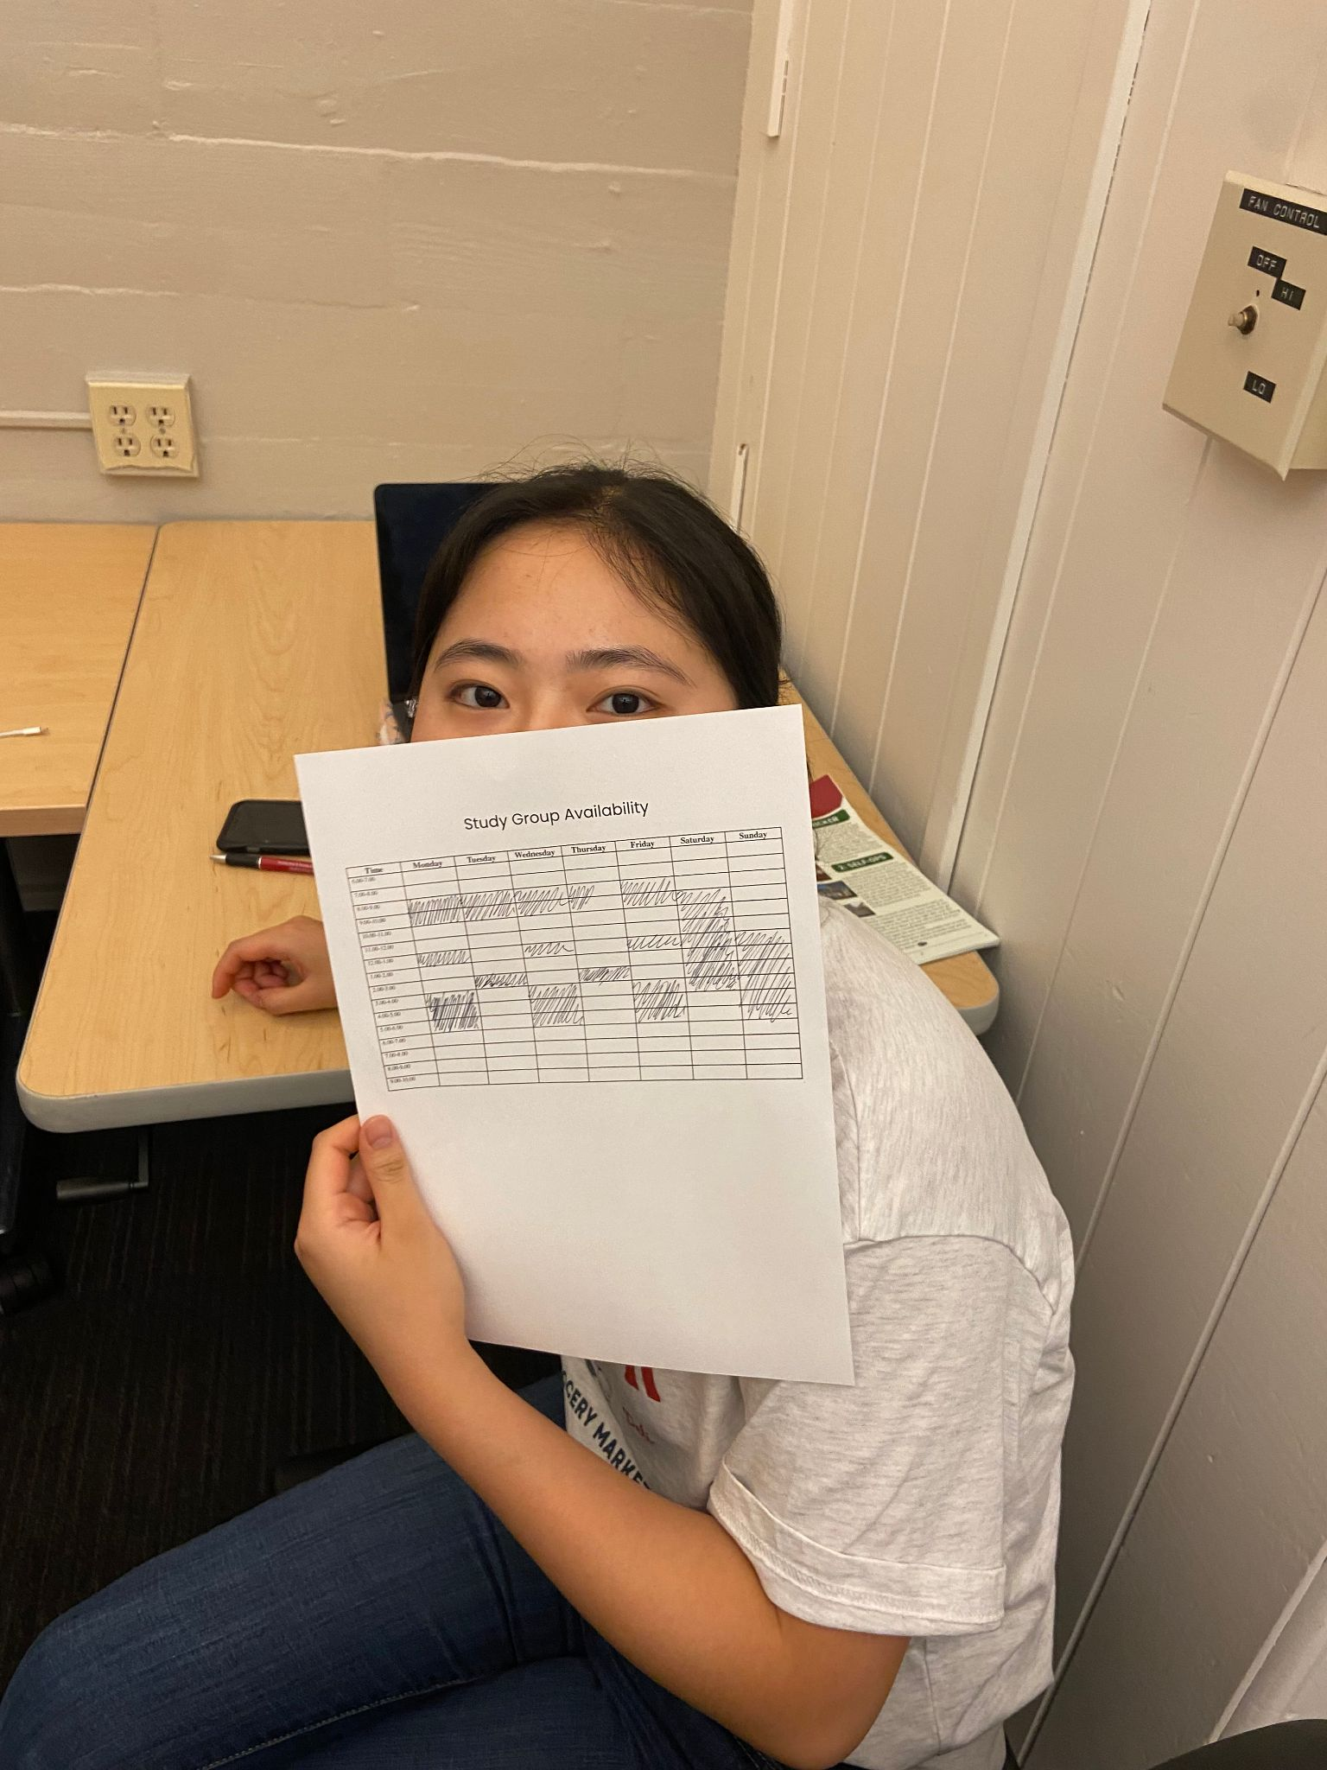
Photos

Slide 31
Key Assumption #3
Solution
Assumption
A shared resource bank made by students that you can query with a LLM
People want to ask study app or resource questions to a LLM

Slide 32
Prototype Context #3
Assumption
People want to ask study app or resource questions to a LLM
Experience Prototype
Props: Text message thread that acts as an “LLM” with people ready to respond after user sends questions. Discussion after exercise
Participants & Relevance: Participant was a Stanford student interested in EE, with industry background. Recruited as a friend and particularly relevant because they are back after a leave and are trying to figure out study/resource help
Method: Participant was asked to text the LLM whenever they had questions on classes, studying, or resources over a 3-hour period. Person was on standby to reply as an LLM, using knowledge of Stanford & EE

Slide 33

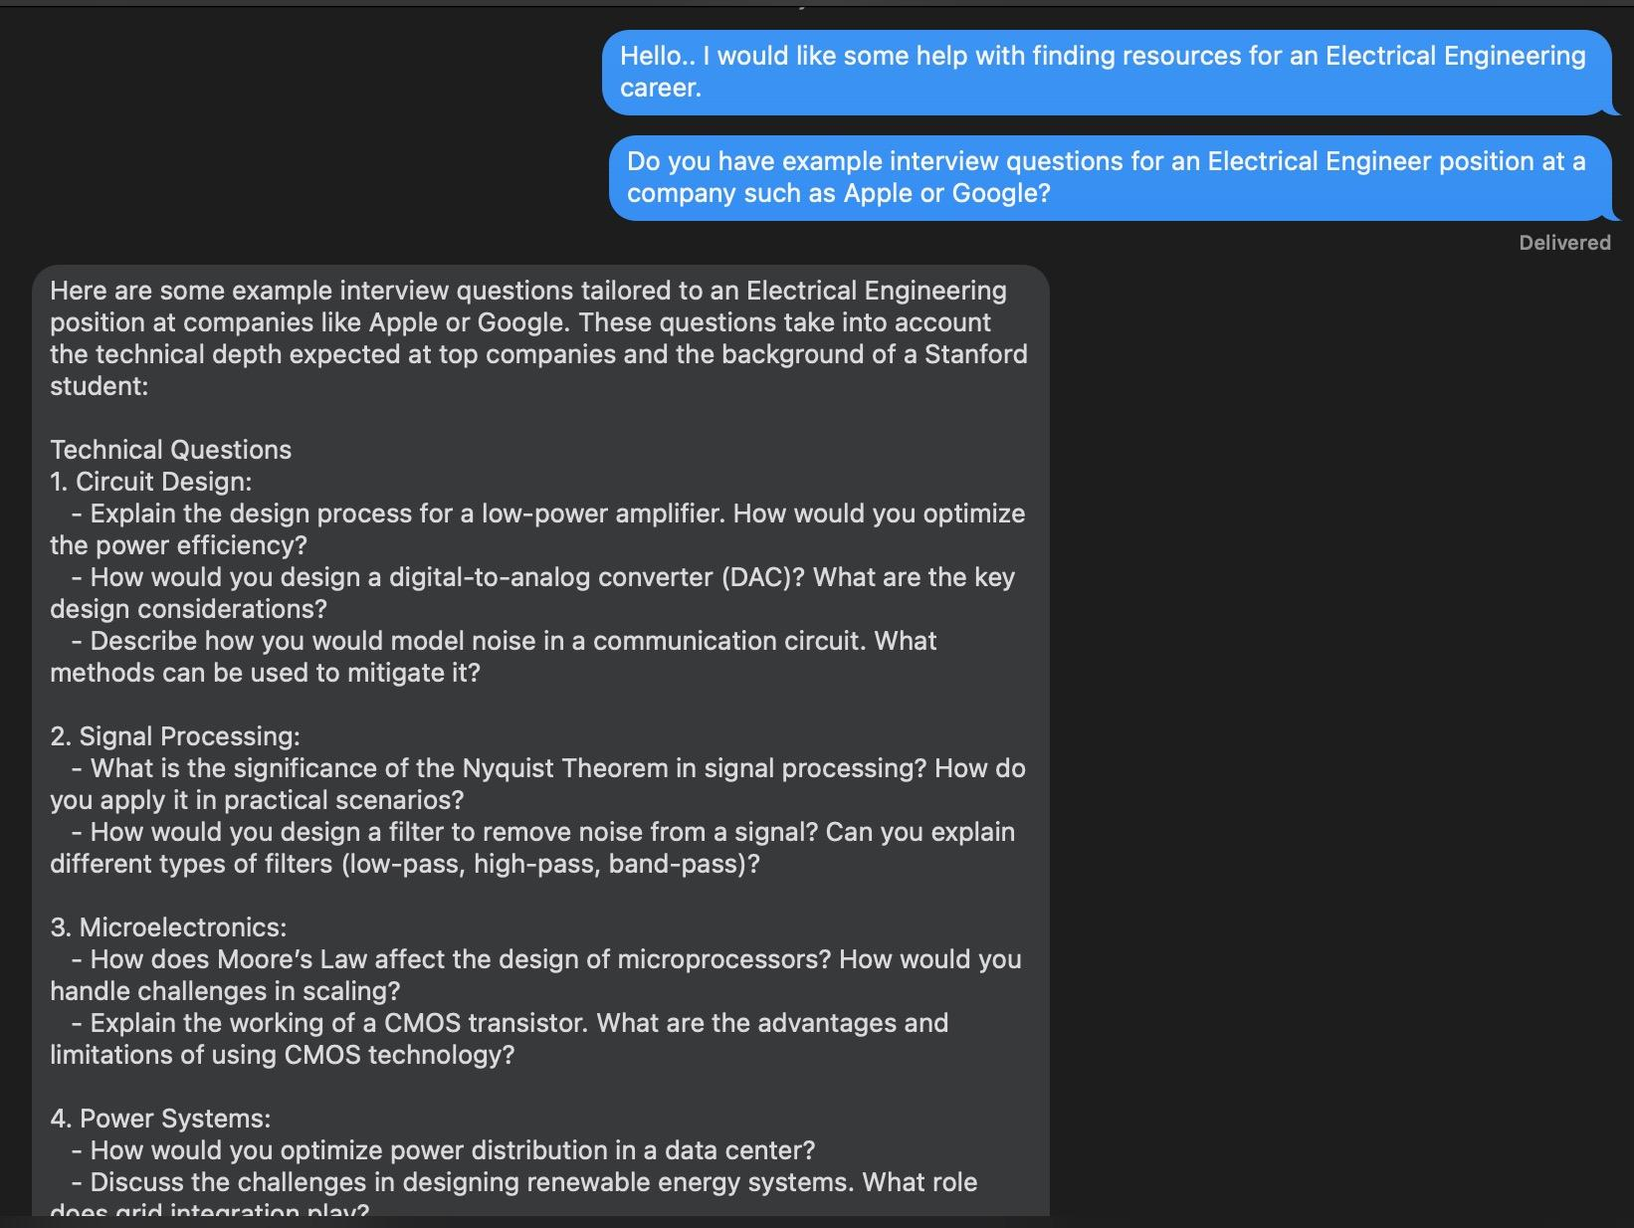
Description
We created an “LLM” that takes in user questions related to school/career and returns outlined steps reaching said goals or relevant resources
Experience Prototype
What worked: Participants appreciated how easy it was to use and the range of functionality (how to access X resource? How to best study for [class]? What classes / actions can I take to break into Y career?
What didn’t: 1) Scraping for very niche or protected information is difficult, could lead to generic or unhelpful answers. 2) Training on school-specific information has many barriers
Assumption: Validated, users find LLMs useful for asking a variety of questions and tend to do so without hesitation (less confrontational than asking others)

Slide 34
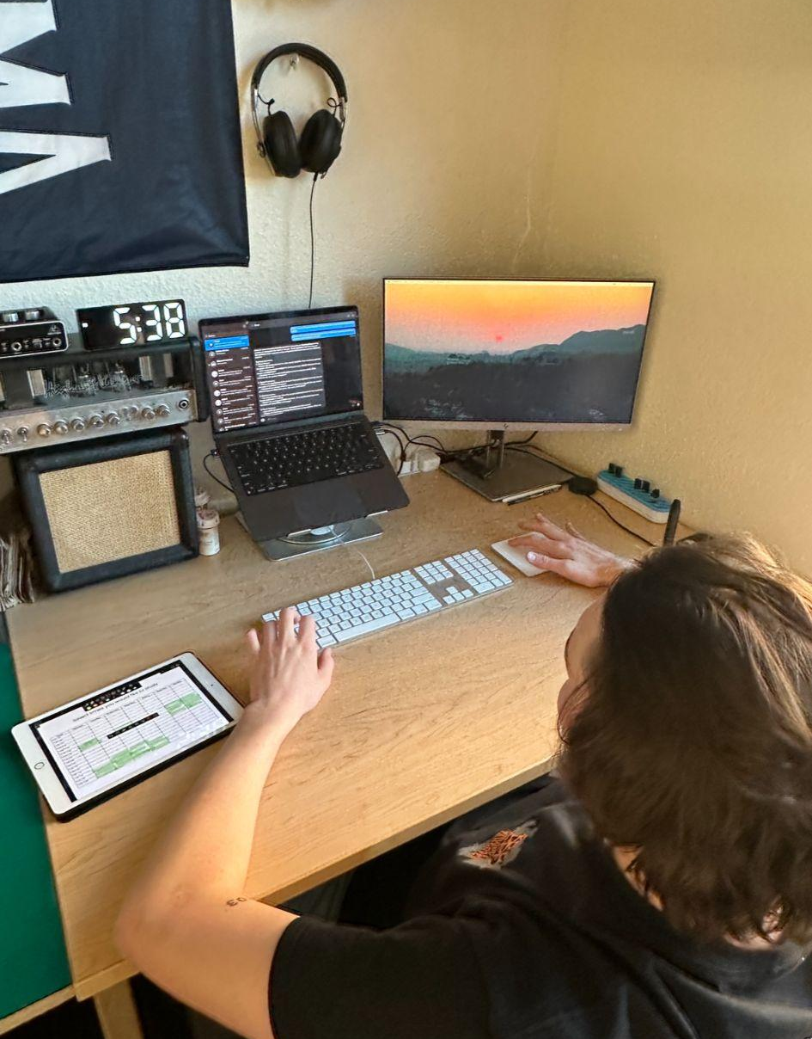
Photos!
Types of Questions asked
Interview question examples
Resources to prepare for interview, and the job itself
Classes to take in order to prepare for specific jobs/careers
Subject matter to study outside of class in order to prepare for a job
Study materials and alternative textbooks to use for studying specific subject matter

Slide 35
06
WHATS NEXT?

Slide 36
Moving Forward…
Going forward: we will work on an app that matches study partners/groups based on academic goals, availability, and personality test. Received really positive and is something students we’re excited in using.
Ethical implications: user privacy and data, transparent matching algorithm, how to mitigate bias in matching, creating diversity in matches
Who does it serve: students with similar academic goals/interests who are interested in forming study groups/partners in classes!
Who might it leave out: students that don’t have the resources to use an app, with disabilities, who would not like being matched by an algorithm

Slide 37
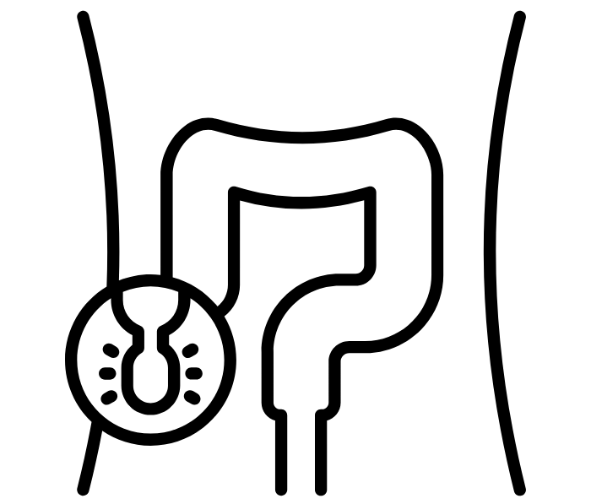
07
APPENDIX

Slide 38
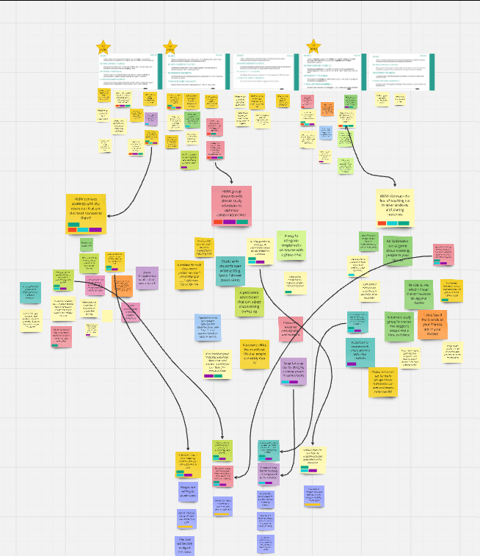
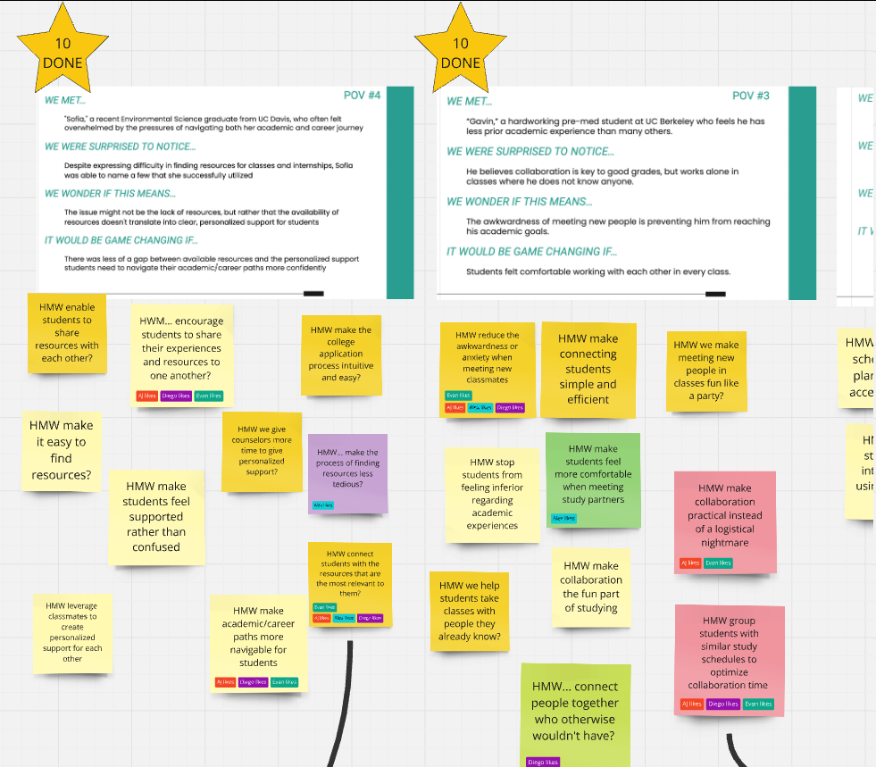
Brainstorming Board Photos
Notes:
https://miro.com/app/board/uXjVLVtCV8o=/?share_link_id=131668477850 (Link to MIRO board with complete ideations)

Slide 39
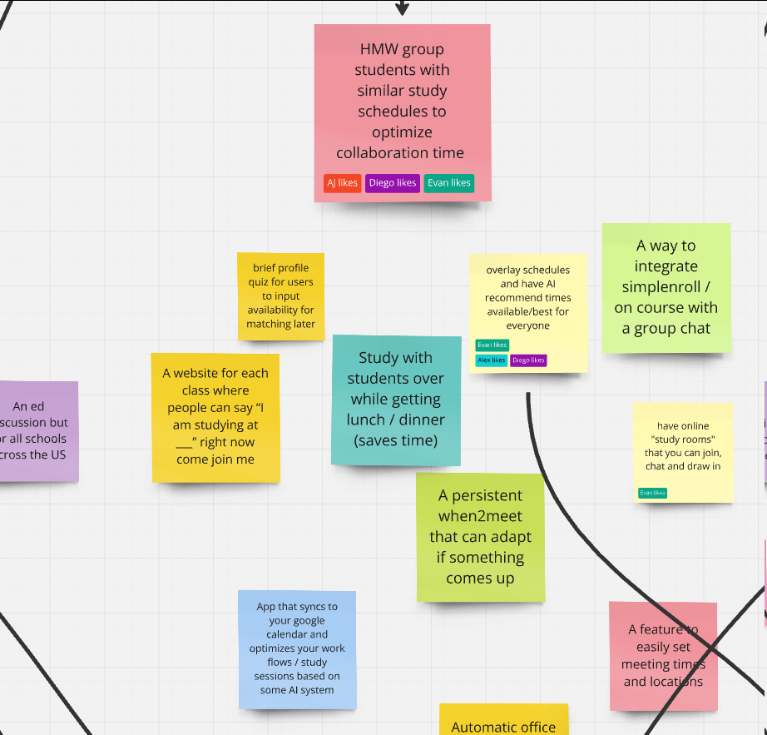
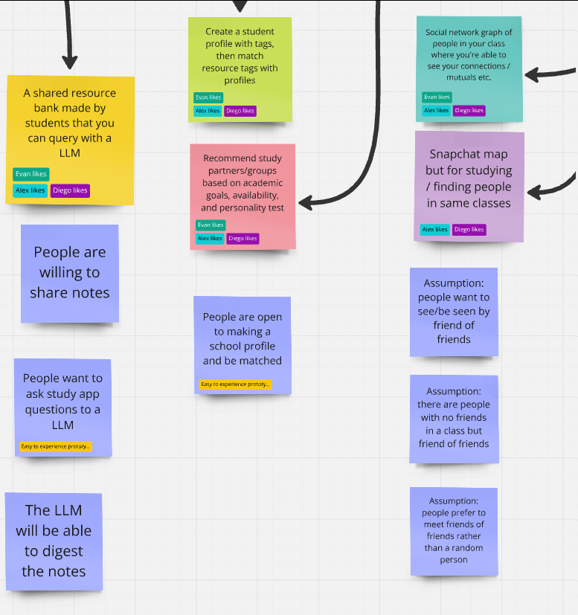
Brainstorming Board Photos

Slide 40
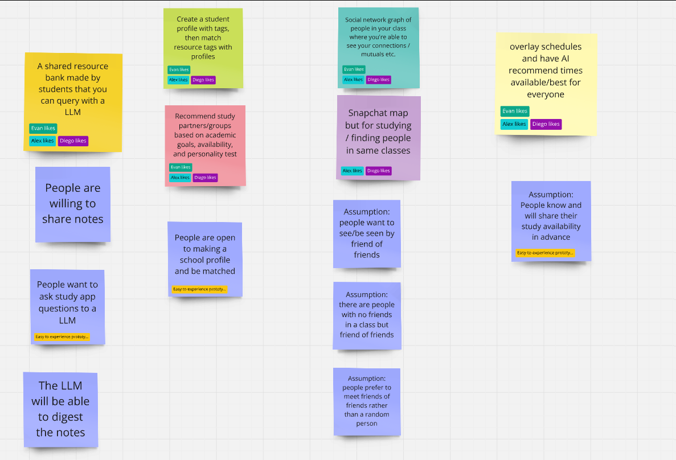
Assumptions

